Slide 1
5. Graphs
Part 2

Slide 2
Objectives
2
Spanning Trees
Prim algorithm
Kruskal algorithm
Eulerian and Hamilton Graphs
Graph coloring

Slide 3
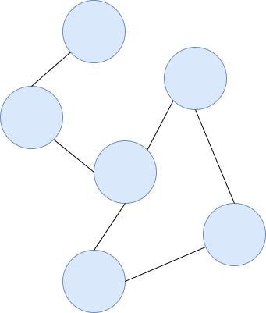
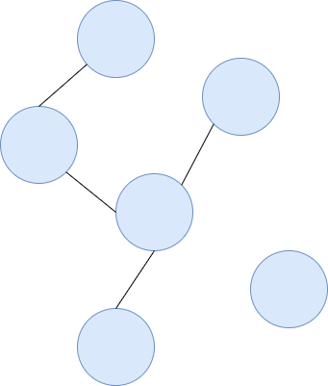
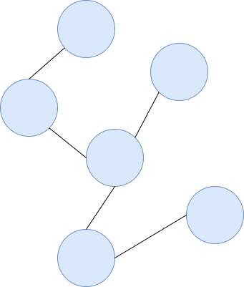
What is Spanning Tree
Tree: undirected, connected graph without simple cycles.
H1. GRAPH
H2. TREE
Spanning tree: a tree that includes all vertices of the original graph
H3. SPANNING TREE
Notes:
Spanning stree là một tập con của Đồ thị G, có tất cả các đỉnh được phủ với số cạnh tối thiểu có thể. Do đó, Spanning stree không có chu kỳ và nó không thể bị ngắt kết nối ..
Theo định nghĩa này, chúng ta có thể rút ra kết luận rằng mọi Đồ thị G được kết nối và vô hướng đều có ít nhất một Spanning stree . Một đồ thị bị ngắt kết nối không có bất kỳ Spanning stree nào, vì nó không thể được mở rộng đến tất cả các đỉnh của nó.
Ở hình trên ta thấy một đồ thị 3 nút hoàn chỉnh, Một đồ thị vô hướng hoàn chỉnh có thể có tối đa n ^{n-2} số cây khung, trong đó n là số nút. Trong ví dụ nêu trên, n là 3, do đó có thể có 3 ³⁻² = 3 cây khung.

Slide 4
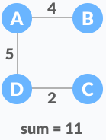
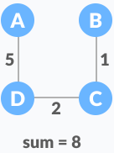
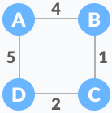

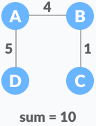
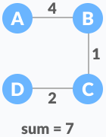
Minimum Spanning Tree (MST)
4
- A spanning tree in which the sum of the weight of the edges is as minimum as possible.
Example:
H2
H3
The initial graph is:
H1
H4
H5
Notes:
Minimum Spanning Tree là Spanning Tree trong đó tổng trọng số của các cạnh là nhỏ nhất có thể.
4

Slide 5
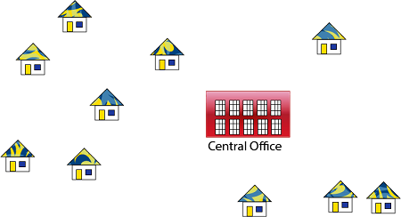
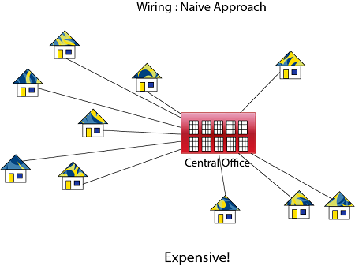
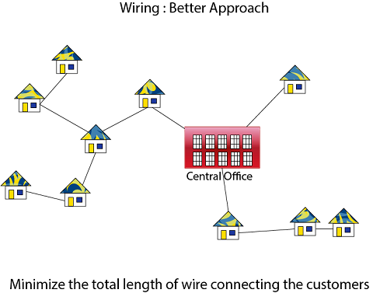
Application of Spanning Tree
PURPOSE
IDEA
Notes:
Spanning tree về cơ bản được sử dụng để tìm một đường dẫn tối thiểu để kết nối tất cả các nút trong một đồ thị. Ứng dụng phổ biến của cây bao trùm là -
Quy hoạch mạng dân sự
Giao thức định tuyến mạng máy tính
Phân tích cluster
Hãy để chúng tôi hiểu điều này qua một ví dụ nhỏ. Hãy xem xét, mạng thành phố như một biểu đồ khổng lồ và hiện có kế hoạch triển khai các đường dây điện thoại theo cách mà trong các đường dây tối thiểu, chúng ta có thể kết nối với tất cả các nút của thành phố. Đây là lúc cây bao trùm đi vào hình ảnh.

Slide 6
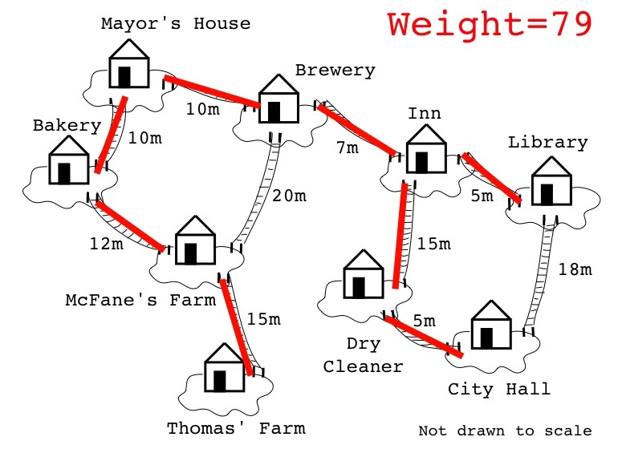
Application of Spanning Tree
Network Design
Construct highways or railroads spanning several cities
Notes:
Spanning tree về cơ bản được sử dụng để tìm một đường dẫn tối thiểu để kết nối tất cả các nút trong một đồ thị. Ứng dụng phổ biến của cây bao trùm là -
Quy hoạch mạng dân sự
Giao thức định tuyến mạng máy tính
Phân tích cluster
Hãy để chúng tôi hiểu điều này qua một ví dụ nhỏ. Hãy xem xét, mạng thành phố như một biểu đồ khổng lồ và hiện có kế hoạch triển khai các đường dây điện thoại theo cách mà trong các đường dây tối thiểu, chúng ta có thể kết nối với tất cả các nút của thành phố. Đây là lúc cây bao trùm đi vào hình ảnh.

Slide 7
MST algorithms
The minimum spanning tree from a graph is found using the following algorithms:
Prim's Algorithm
Kruskal's Algorithm
Notes:
7

Slide 8
MST Prim-Jarnik Algorithm
8
Step 1: Initialize a tree with a single vertex, chosen arbitrarily from the graph.
Step 2: Grow the tree by one edge: of the edges that connect the tree to vertices not yet in the tree, find the minimum-weight edge, and transfer it to the tree.
Step 3: Repeat step 2 (until all vertices are in the tree).
Notes:
|E| = number of edges
|V| = number of vertices
8

Slide 9
Example: Prim's Algorithm
2
A
B
1
1
5
2
1
E
1
D
C
5
3
6
G
10
2
F
Sets: (A) (B) (C) (D) (E) (F) (G)
Output:

Slide 10
Example: Prim's Algorithm
2
A
B
1
1
5
2
1
E
1
D
C
5
3
6
G
10
2
F
Sets: (A) (B) (C) (D) (E) (F) (G)
Output:

Slide 11
Example: Prim's Algorithm
2
A
B
1
1
5
2
1
E
1
D
C
5
3
6
G
10
2
F
Sets: (A,D) (B) (C) (E) (F) (G)
Output: (A,D)

Slide 12
Example: Prim's Algorithm
2
A
B
1
1
5
NOTE:
Algorithm does not show a continuous path through the steps
Step-by-step results just contribute to spanning tree in the final result
2
1
E
1
D
C
5
3
6
G
10
2
F
Sets: (A,C,D) (B) (E) (F) (G)
Output: (A,D) (C,D)

Slide 13
Example: Prim's Algorithm
2
A
B
1
1
5
2
1
E
1
D
C
5
3
6
G
10
2
F
Sets: (A,C,D,E) (B) (F) (G)
Output: (A,D) (C,D) (D,E)

Slide 14
Example: Prim's Algorithm
2
A
B
1
1
5
2
1
E
1
D
C
5
3
6
G
10
2
F
Sets: (A,C,D,E,B) (F) (G)
Output: (A,D) (C,D) (D,E) (B,E)

Slide 15
Example: Prim's Algorithm
2
A
B
1
1
5
2
1
E
1
D
C
5
3
6
G
10
2
F
Sets: (A,C,D,E,B,F) (G)
Output: (A,D) (C,D) (D,E) (B,E) (C,F)

Slide 16
Example: Prim's Algorithm
2
A
B
1
1
5
2
1
E
1
D
C
5
3
6
G
10
2
F
Sets: (A,C,D,E,B,F,G)
Output: (A,D) (C,D) (D,E) (B,E) (C,F) (E,G)
Total cost: 9

Slide 17
Kruskal Algorithm
17
Step 1: Sort all the edges from low weight to high
Step 2: Take the edge with the lowest weight and add it to the spanning tree. If adding the edge created a cycle, then reject this edge
Step 3: Keep adding edges until we reach all vertices
Notes:
Sắp xếp tất cả các cạnh từ trọng lượng thấp đến cao
Lấy cạnh có trọng số thấp nhất và thêm nó vào cây khung. Nếu thêm cạnh tạo ra một chu trình, thì bác bỏ cạnh này.
Tiếp tục thêm các cạnh cho đến khi chúng ta đạt được tất cả các đỉnh.
17

Slide 18
Example: Kruskal's Algorithm
Edges in sorted order:
1: (A,D) (C,D) (B,E) (D,E)
2: (A,B) (C,F) (A,C)
3: (E,G)
5: (D,G) (B,D)
6: (D,F)
10: (F,G)
2
A
B
1
1
5
2
1
E
1
D
C
5
3
6
G
10
2
F
Sets: (A) (B) (C) (D) (E) (F) (G)
Output:
At each step, the union/find sets are the trees in the forest

Slide 19
Example: Kruskal's Algorithm
Edges in sorted order:
1: (A,D) (C,D) (B,E) (D,E)
2: (A,B) (C,F) (A,C)
3: (E,G)
5: (D,G) (B,D)
6: (D,F)
10: (F,G)
2
A
B
1
1
5
2
1
E
1
D
C
5
3
6
G
10
2
F
Sets: (A,D) (B) (C) (E) (F) (G)
Output: (A,D)
At each step, the union/find sets are the trees in the forest

Slide 20
Example: Kruskal's Algorithm
Edges in sorted order:
1: (A,D) (C,D) (B,E) (D,E)
2: (A,B) (C,F) (A,C)
3: (E,G)
5: (D,G) (B,D)
6: (D,F)
10: (F,G)
2
A
B
1
1
5
2
1
E
1
D
C
5
3
6
G
10
2
F
NOTE:
Algorithm does not show a continuous path through the steps
Step-by-step results just contribute to spanning tree in the final result
Sets: (A,C,D) (B) (E) (F) (G)
Output: (A,D) (C,D)
At each step, the union/find sets are the trees in the forest

Slide 21
Example: Kruskal's Algorithm
Edges in sorted order:
1: (A,D) (C,D) (B,E) (D,E)
2: (A,B) (C,F) (A,C)
3: (E,G)
5: (D,G) (B,D)
6: (D,F)
10: (F,G)
2
A
B
1
1
5
2
1
E
1
D
C
5
3
6
G
10
2
F
Sets: (A,C,D) (B,E) (F) (G)
Output: (A,D) (C,D) (B,E)
At each step, the union/find sets are the trees in the forest

Slide 22
Example: Kruskal's Algorithm
Edges in sorted order:
1: (A,D) (C,D) (B,E) (D,E)
2: (A,B) (C,F) (A,C)
3: (E,G)
5: (D,G) (B,D)
6: (D,F)
10: (F,G)
2
A
B
1
1
5
2
1
E
1
D
C
5
3
6
G
10
2
F
Sets: (A,B,C,D,E) (F) (G)
Output: (A,D) (C,D) (B,E) (D,E)
At each step, the union/find sets are the trees in the forest

Slide 23
Example: Kruskal's Algorithm
Edges in sorted order:
1: (A,D) (C,D) (B,E) (D,E)
2: (A,B) (C,F) (A,C)
3: (E,G)
5: (D,G) (B,D)
6: (D,F)
10: (F,G)
A
B
1
1
5
2
1
E
1
D
C
5
3
6
G
10
2
F
Sets: (A,B,C,D,E) (F) (G)
Output: (A,D) (C,D) (B,E) (D,E)
At each step, the union/find sets are the trees in the forest

Slide 24
Example: Kruskal's Algorithm
Edges in sorted order:
1: (A,D) (C,D) (B,E) (D,E)
2: (A,B) (C,F) (A,C)
3: (E,G)
5: (D,G) (B,D)
6: (D,F)
10: (F,G)
A
B
1
1
5
2
1
E
1
D
C
5
3
6
G
10
2
F
Sets: (A,B,C,D,E,F) (G)
Output: (A,D) (C,D) (B,E) (D,E) (C,F)
At each step, the union/find sets are the trees in the forest

Slide 25
Example: Kruskal's Algorithm
Edges in sorted order:
1: (A,D) (C,D) (B,E) (D,E)
2: (A,B) (C,F) (A,C)
3: (E,G)
5: (D,G) (B,D)
6: (D,F)
10: (F,G)
A
B
1
1
5
1
E
1
D
C
5
3
6
G
10
2
F
Sets: (A,B,C,D,E,F) (G)
Output: (A,D) (C,D) (B,E) (D,E) (C,F)
At each step, the union/find sets are the trees in the forest

Slide 26
Example: Kruskal's Algorithm
Edges in sorted order:
1: (A,D) (C,D) (B,E) (D,E)
2: (A,B) (C,F) (A,C)
3: (E,G)
5: (D,G) (B,D)
6: (D,F)
10: (F,G)
A
B
1
1
5
1
E
1
D
C
5
3
6
G
10
2
F
Sets: (A,B,C,D,E,F,G)
Output: (A,D) (C,D) (B,E) (D,E) (C,F) (E,G)
Total cost: 9
At each step, the union/find sets are the trees in the forest

Slide 27
The Bridges of Königsberg (Russia)
Euler cycle and paths
C
C
A D
B
A
D
B
Consider each region A, B, C, D as a vertex and each bridge is an edge connecting two vertices, then we have Konigsberg's diagram as a polygraph G as shown above
Problem becomes: Find an simple cycle that goes through all the edge of the graph ➔ Euler cycle?

Slide 28
Euler cycle and paths
1. Euler cycle: a cycle traversing all the edges of the graph exactly once and return to the same starting point.
Has Euler cycle
2. Euler path: a path traversing all the edges of the graph exactly once
Has Euler path,
but no Euler cycle
Data Structures and Algorithms in Java
28/30

Slide 29
Necessary and sufficient conditions for Euler cycles
Theorem 1: A connected multigraph has an Euler cycle if and only if each of its vertices has even degree.
No Euler cycle
no Euler path
Has Euler cycle
C
A D
B
Euler cycle???
path???
Has Euler path,
but no Euler cycle

Slide 30
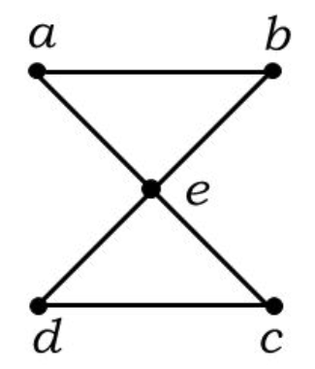
Necessary condition for Euler cycle
A connected multigraph has an Euler cycle ➔ each of its vertices has even degree
Assume the graph has an Euler cycle.
Every time the cycle passes through a vertex, it increase 2 to the vertex’s degree.
All the egdes of graph appear exactly once.
➔ Each vertices has even degree.

Slide 31
Sufficient condition for Euler cycle
A connected multigraph G, each of its vertices has even degree ➔ G has an Euler cycle
Start at an arbitrary vertex v₀, choose an arbitrary edge (e₁). Then from v₁, choose edge (e₂) (e₂ ≠ e₁) and so on.
Process will arrive at the starting vertex v₀, create a cycle with distinct edges.
If the cycle includes all edges of G, this will be an Euler cycle; if not, begin the procedure again from a vertex contained in this cycle and splice the two cycles together; continue until all edges are used.
➔ G has an Euler cycle
v₁
e₁
e₂
v₀
v₂
…
…
e₃
G

Slide 32
A procedure for constructing an Euler cycle
Algorithm
Input: Connected graph G with all vertices having even degrees
Output: Euler cycle
1. Construct a cycle in G
2. Remove all the edges of cycle from G to get subgraph H
3. while H has edges
Find a non-isolated vertex v that is both in cycle and in H.
Construct subcycle in H.
Splice subcycle into cycle at v such that not construct the already cycle.
Remove all the edges of subcycle from H.
4. return cycle
Example
1 3 5 7
2 4 6 8
G
1 3 5 7
2 4 6 8
Cycle
1231
1

Slide 33
A procedure for constructing an Euler cycle
Algorithm
Input: Connected graph G with all vertices having even degrees
Output: Euler cycle
1. Construct a cycle in G
2. Remove all the edges of cycle from G to get subgraph H
3. while H has edges
Find a non-isolated vertex v that is both in cycle and in H.
Construct subcycle in H.
Splice subcycle into cycle at v such that not construct the already cycle.
Remove all the edges of subcycle from H.
4. return cycle
Example
1 3 5 7
2 4 6 8
H
2
1 3 5 7
2 4 6 8
subcycle
34653
3

Slide 34
A procedure for constructing an Euler cycle
Algorithm
Input: Connected graph G with all vertices having even degrees
Output: Euler cycle
1. Construct a cycle in G
2. Remove all the edges of cycle from G to get subgraph H
3. while H has edges
Find a non-isolated vertex v that is both in cycle and in H.
Construct subcycle in H.
Splice subcycle into cycle at v such that not construct the already cycle.
Remove all the edges of subcycle from H.
4. return cycle
Example
1 3 5 7
2 4 6 8
splicing
34653 into
1231 ➔
12346531
4
1 3 5 7
2 4 6 8
H
5

Slide 35
A procedure for constructing an Euler cycle
Algorithm
Input: Connected graph G with all vertices having even degrees
Output: Euler cycle
1. Construct a cycle in G
2. Remove all the edges of cycle from G to get subgraph H
3. while H has edges
Find a non-isolated vertex v that is both in cycle and in H.
Construct subcycle in H.
Splice subcycle into cycle at v such that not construct the already cycle.
Remove all the edges of subcycle from H.
4. return cycle
Example
1 3 5 7
2 4 6 8
6
1 3 5 7
2 4 6 8
H
7

Slide 36
A procedure for constructing an Euler cycle
Algorithm
Input: Connected graph G with all vertices having even degrees
Output: Euler cycle
1. Construct a cycle in G
2. Remove all the edges of cycle from G to get subgraph H
3. while H has edges
Find a non-isolated vertex v that is both in cycle and in H.
Construct subcycle in H.
Splice subcycle into cycle at v such that not construct the already cycle.
Remove all the edges of subcycle from H.
4. return cycle
Example
1 3 5 7
2 4 6 8
splicing
6786 into
12346531 →
12346786531
8
1 3 5 7
2 4 6 8
H
➔ Euler cycle obtained
12346786531

Slide 37
Algorithm for finding an Euler cycle from the vertex X using stack
Input: Connected graph G with all vertices having even degrees
Output: Euler cycle
Step 1: Declare a stack S and an empty array E (which will contain Euler cycle)
Step 2: Push the vertex X to S
Step 3: T = top element (first element) of the stack S
if T is isolated then remove it from the stack and put it to E
else select the first vertex Y which is adjacent to T, push Y to S and remove the edge (T, Y) from the graph
Step 4: Go back to Step 3 until stack S is empty.
The last array E obtained is an Euler cycle of the graph
A
B
C
D
E
Graph G
S = { }
E = { }

Slide 38
Algorithm for finding an Euler cycle from the vertex X using stack
Input: Connected graph G with all vertices having even degrees
Output: Euler cycle
Step 1: Declare a stack S and an empty array E (which will contain Euler cycle)
Step 2: Push the vertex X to S
Step 3: T = top element (first element) of the stack S
if T is isolated then remove it from the stack and put it to E
else select the first vertex Y which is adjacent to T, push Y to S and remove the edge (T, Y) from the graph
Step 4: Go back to Step 3 until stack S is empty.
The last array E obtained is an Euler cycle of the graph
A
B
C
D
E
Graph G
S = {A}
E = { }

Slide 39
Algorithm for finding an Euler cycle from the vertex X using stack
Input: Connected graph G with all vertices having even degrees
Output: Euler cycle
Step 1: Declare a stack S and an empty array E (which will contain Euler cycle)
Step 2: Push the vertex X to S
Step 3: T = top element (first element) of the stack S
if T is isolated then remove it from the stack and put it to E
else select the first vertex Y which is adjacent to T, push Y to S and remove the edge (T, Y) from the graph
Step 4: Go back to Step 3 until stack S is empty.
The last array E obtained is an Euler cycle of the graph
A
B
C
D
E
Graph G
S = {A}
E = { }

Slide 40
Algorithm for finding an Euler cycle from the vertex X using stack
Input: Connected graph G with all vertices having even degrees
Output: Euler cycle
Step 1: Declare a stack S and an empty array E (which will contain Euler cycle)
Step 2: Push the vertex X to S
Step 3: T = top element (first element) of the stack S
if T is isolated then remove it from the stack and put it to E
else select the first vertex Y which is adjacent to T, push Y to S and remove the edge (T, Y) from the graph
Step 4: Go back to Step 3 until stack S is empty.
The last array E obtained is an Euler cycle of the graph
A
B
C
D
E
Graph G
S = {B,A}
E = { }

Slide 41
Algorithm for finding an Euler cycle from the vertex X using stack
Input: Connected graph G with all vertices having even degrees
Output: Euler cycle
Step 1: Declare a stack S and an empty array E (which will contain Euler cycle)
Step 2: Push the vertex X to S
Step 3: T = top element (first element) of the stack S
if T is isolated then remove it from the stack and put it to E
else select the first vertex Y which is adjacent to T, push Y to S and remove the edge (T, Y) from the graph
Step 4: Go back to Step 3 until stack S is empty.
The last array E obtained is an Euler cycle of the graph
A
B
C
D
E
Graph G
S = {C,B,A}
E = { }

Slide 42
Algorithm for finding an Euler cycle from the vertex X using stack
Input: Connected graph G with all vertices having even degrees
Output: Euler cycle
Step 1: Declare a stack S and an empty array E (which will contain Euler cycle)
Step 2: Push the vertex X to S
Step 3: T = top element (first element) of the stack S
if T is isolated then remove it from the stack and put it to E
else select the first vertex Y which is adjacent to T, push Y to S and remove the edge (T, Y) from the graph
Step 4: Go back to Step 3 until stack S is empty.
The last array E obtained is an Euler cycle of the graph
A
B
C
D
E
Graph G
S = {A,C,B,A}
E = { }

Slide 43
Algorithm for finding an Euler cycle from the vertex X using stack
Input: Connected graph G with all vertices having even degrees
Output: Euler cycle
Step 1: Declare a stack S and an empty array E (which will contain Euler cycle)
Step 2: Push the vertex X to S
Step 3: T = top element (first element) of the stack S
if T is isolated then remove it from the stack and put it to E
else select the first vertex Y which is adjacent to T, push Y to S and remove the edge (T, Y) from the graph
Step 4: Go back to Step 3 until stack S is empty.
The last array E obtained is an Euler cycle of the graph
A
B
C
D
E
Graph G
S = {C,B,A}
E = {A}

Slide 44
Algorithm for finding an Euler cycle from the vertex X using stack
Input: Connected graph G with all vertices having even degrees
Output: Euler cycle
Step 1: Declare a stack S and an empty array E (which will contain Euler cycle)
Step 2: Push the vertex X to S
Step 3: T = top element (first element) of the stack S
if T is isolated then remove it from the stack and put it to E
else select the first vertex Y which is adjacent to T, push Y to S and remove the edge (T, Y) from the graph
Step 4: Go back to Step 3 until stack S is empty.
The last array E obtained is an Euler cycle of the graph
A
B
C
D
E
Graph G
S = {D,C,B,A}
E = {A}

Slide 45
Algorithm for finding an Euler cycle from the vertex X using stack
Input: Connected graph G with all vertices having even degrees
Output: Euler cycle
Step 1: Declare a stack S and an empty array E (which will contain Euler cycle)
Step 2: Push the vertex X to S
Step 3: T = top element (first element) of the stack S
if T is isolated then remove it from the stack and put it to E
else select the first vertex Y which is adjacent to T, push Y to S and remove the edge (T, Y) from the graph
Step 4: Go back to Step 3 until stack S is empty.
The last array E obtained is an Euler cycle of the graph
A
B
C
D
E
Graph G
S = {E,D,C,B,A}
E = {A}

Slide 46
Algorithm for finding an Euler cycle from the vertex X using stack
Input: Connected graph G with all vertices having even degrees
Output: Euler cycle
Step 1: Declare a stack S and an empty array E (which will contain Euler cycle)
Step 2: Push the vertex X to S
Step 3: T = top element (first element) of the stack S
if T is isolated then remove it from the stack and put it to E
else select the first vertex Y which is adjacent to T, push Y to S and remove the edge (T, Y) from the graph
Step 4: Go back to Step 3 until stack S is empty.
The last array E obtained is an Euler cycle of the graph
A
B
C
D
E
Graph G
S = {C,E,D,C,B,A}
E = {A}

Slide 47
Algorithm for finding an Euler cycle from the vertex X using stack
Input: Connected graph G with all vertices having even degrees
Output: Euler cycle
Step 1: Declare a stack S and an empty array E (which will contain Euler cycle)
Step 2: Push the vertex X to S
Step 3: T = top element (first element) of the stack S
if T is isolated then remove it from the stack and put it to E
else select the first vertex Y which is adjacent to T, push Y to S and remove the edge (T, Y) from the graph
Step 4: Go back to Step 3 until stack S is empty.
The last array E obtained is an Euler cycle of the graph
A
B
C
D
E
Graph G
S = {E,D,C,B,A}
E = {A,C}

Slide 48
Algorithm for finding an Euler cycle from the vertex X using stack
Input: Connected graph G with all vertices having even degrees
Output: Euler cycle
Step 1: Declare a stack S and an empty array E (which will contain Euler cycle)
Step 2: Push the vertex X to S
Step 3: T = top element (first element) of the stack S
if T is isolated then remove it from the stack and put it to E
else select the first vertex Y which is adjacent to T, push Y to S and remove the edge (T, Y) from the graph
Step 4: Go back to Step 3 until stack S is empty.
The last array E obtained is an Euler cycle of the graph
A
B
C
D
E
Graph G
S = {D,C,B,A}
E = {A,C,E}

Slide 49
Algorithm for finding an Euler cycle from the vertex X using stack
Input: Connected graph G with all vertices having even degrees
Output: Euler cycle
Step 1: Declare a stack S and an empty array E (which will contain Euler cycle)
Step 2: Push the vertex X to S
Step 3: T = top element (first element) of the stack S
if T is isolated then remove it from the stack and put it to E
else select the first vertex Y which is adjacent to T, push Y to S and remove the edge (T, Y) from the graph
Step 4: Go back to Step 3 until stack S is empty.
The last array E obtained is an Euler cycle of the graph
A
B
C
D
E
Graph G
S = {C,B,A}
E = {A,C,E,D}

Slide 50
Algorithm for finding an Euler cycle from the vertex X using stack
Input: Connected graph G with all vertices having even degrees
Output: Euler cycle
Step 1: Declare a stack S and an empty array E (which will contain Euler cycle)
Step 2: Push the vertex X to S
Step 3: T = top element (first element) of the stack S
if T is isolated then remove it from the stack and put it to E
else select the first vertex Y which is adjacent to T, push Y to S and remove the edge (T, Y) from the graph
Step 4: Go back to Step 3 until stack S is empty.
The last array E obtained is an Euler cycle of the graph
A
B
C
D
E
Graph G
S = {B,A}
E = {A,C,E,D,C}

Slide 51
Algorithm for finding an Euler cycle from the vertex X using stack
Input: Connected graph G with all vertices having even degrees
Output: Euler cycle
Step 1: Declare a stack S and an empty array E (which will contain Euler cycle)
Step 2: Push the vertex X to S
Step 3: T = top element (first element) of the stack S
if T is isolated then remove it from the stack and put it to E
else select the first vertex Y which is adjacent to T, push Y to S and remove the edge (T, Y) from the graph
Step 4: Go back to Step 3 until stack S is empty.
The last array E obtained is an Euler cycle of the graph
A
B
C
D
E
Graph G
S = {A}
E = {A,C,E,D,C,B}

Slide 52
Algorithm for finding an Euler cycle from the vertex X using stack
Input: Connected graph G with all vertices having even degrees
Output: Euler cycle
Step 1: Declare a stack S and an empty array E (which will contain Euler cycle)
Step 2: Push the vertex X to S
Step 3: T = top element (first element) of the stack S
if T is isolated then remove it from the stack and put it to E
else select the first vertex Y which is adjacent to T, push Y to S and remove the edge (T, Y) from the graph
Step 4: Go back to Step 3 until stack S is empty.
The last array E obtained is an Euler cycle of the graph
A
B
C
D
E
Graph G
S = { }
E = {A,C,E,D,C,B,A}
→Result: A, C, E, D, C, B, A

Slide 53
Necessary and sufficient conditions for Euler paths
Theorem 2: A connected multigraph has an Euler path but not an Euler cycle if and only if it has exactly two vertices of odd degree.
G
End point
Start point

Slide 54
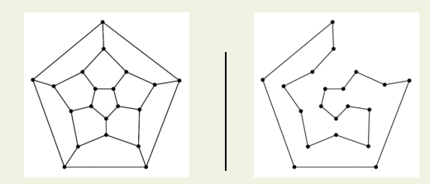
Hamilton paths and cycles
Hamilton cycle: visits every vertex of the graph exactly once before returning, as the last step, to the starting vertex.
Examples:
Hamilton path: visits every vertex of the graph exactly once.

Slide 55
Finding Hamilton’s cycles using Backtracking
Given the graph G = (V,E) and X is a vertex of G. Suppose there exists at least one Hamilton Cycle for the graph.
Step 1: Declare an empty array H (will contain Hamilton cycle). Put the vertex X to H
Step 2: Check if H is a Hamilton cycle then stop, else go to Step 3
Step 3: Consider the last vertex Y in H,
if there is/are vertex(es) adjacent to Y, select an adjacent vertex Z and put it to H.
If there no adjacent vertex, remove Y from H and denote it as a bad selection (so you do not select it in the same way again).
Step 4: Go back to step 2
The last array H obtained is an Hamilton cycle of the graph
2
1
5
3
4
H = {1}

Slide 56
Finding Hamilton’s cycles using Backtracking
Given the graph G = (V,E) and X is a vertex of G. Suppose there exists at least one Hamilton Cycle for the graph.
Step 1: Declare an empty array H (will contain Hamilton cycle). Put the vertex X to H
Step 2: Check if H is a Hamilton cycle then stop, else go to Step 3
Step 3: Consider the last vertex Y in H,
if there is/are vertex(es) adjacent to Y, select an adjacent vertex Z and put it to H.
If there no adjacent vertex, remove Y from H and denote it as a bad selection (so you do not select it in the same way again).
Step 4: Go back to step 2
The last array H obtained is an Hamilton cycle of the graph
2
1
5
3
4
H = {1}

Slide 57
Finding Hamilton’s cycles using Backtracking
Given the graph G = (V,E) and X is a vertex of G. Suppose there exists at least one Hamilton Cycle for the graph.
Step 1: Declare an empty array H (will contain Hamilton cycle). Put the vertex X to H
Step 2: Check if H is a Hamilton cycle then stop, else go to Step 3
Step 3: Consider the last vertex Y in H,
if there is/are vertex(es) adjacent to Y, select an adjacent vertex Z and put it to H.
If there no adjacent vertex, remove Y from H and denote it as a bad selection (so you do not select it in the same way again).
Step 4: Go back to step 2
The last array H obtained is an Hamilton cycle of the graph
2
1
5
3
4
H = {1,2}

Slide 58
Finding Hamilton’s cycles using Backtracking
Given the graph G = (V,E) and X is a vertex of G. Suppose there exists at least one Hamilton Cycle for the graph.
Step 1: Declare an empty array H (will contain Hamilton cycle). Put the vertex X to H
Step 2: Check if H is a Hamilton cycle then stop, else go to Step 3
Step 3: Consider the last vertex Y in H,
if there is/are vertex(es) adjacent to Y, select an adjacent vertex Z and put it to H.
If there no adjacent vertex, remove Y from H and denote it as a bad selection (so you do not select it in the same way again).
Step 4: Go back to step 2
The last array H obtained is an Hamilton cycle of the graph
2
1
5
3
4
H = {1,2,3}

Slide 59
Finding Hamilton’s cycles using Backtracking
Given the graph G = (V,E) and X is a vertex of G. Suppose there exists at least one Hamilton Cycle for the graph.
Step 1: Declare an empty array H (will contain Hamilton cycle). Put the vertex X to H
Step 2: Check if H is a Hamilton cycle then stop, else go to Step 3
Step 3: Consider the last vertex Y in H,
if there is/are vertex(es) adjacent to Y, select an adjacent vertex Z and put it to H.
If there no adjacent vertex, remove Y from H and denote it as a bad selection (so you do not select it in the same way again).
Step 4: Go back to step 2
The last array H obtained is an Hamilton cycle of the graph
2
1
5
3
4
H = {1,2,3,4}

Slide 60
Finding Hamilton’s cycles using Backtracking
Given the graph G = (V,E) and X is a vertex of G. Suppose there exists at least one Hamilton Cycle for the graph.
Step 1: Declare an empty array H (will contain Hamilton cycle). Put the vertex X to H
Step 2: Check if H is a Hamilton cycle then stop, else go to Step 3
Step 3: Consider the last vertex Y in H,
if there is/are vertex(es) adjacent to Y, select an adjacent vertex Z and put it to H.
If there no adjacent vertex, remove Y from H and denote it as a bad selection (so you do not select it in the same way again).
Step 4: Go back to step 2
The last array H obtained is an Hamilton cycle of the graph
2
1
5
3
4
H = {1,2,3,4,1}

Slide 61
Finding Hamilton’s cycles using Backtracking
Given the graph G = (V,E) and X is a vertex of G. Suppose there exists at least one Hamilton Cycle for the graph.
Step 1: Declare an empty array H (will contain Hamilton cycle). Put the vertex X to H
Step 2: Check if H is a Hamilton cycle then stop, else go to Step 3
Step 3: Consider the last vertex Y in H,
if there is/are vertex(es) adjacent to Y, select an adjacent vertex Z and put it to H.
If there no adjacent vertex, remove Y from H and denote it as a bad selection (so you do not select it in the same way again).
Step 4: Go back to step 2
The last array H obtained is an Hamilton cycle of the graph
2
1
5
3
4
H = {1,2,3,4}

Slide 62
Finding Hamilton’s cycles using Backtracking
Given the graph G = (V,E) and X is a vertex of G. Suppose there exists at least one Hamilton Cycle for the graph.
Step 1: Declare an empty array H (will contain Hamilton cycle). Put the vertex X to H
Step 2: Check if H is a Hamilton cycle then stop, else go to Step 3
Step 3: Consider the last vertex Y in H,
if there is/are vertex(es) adjacent to Y, select an adjacent vertex Z and put it to H.
If there no adjacent vertex, remove Y from H and denote it as a bad selection (so you do not select it in the same way again).
Step 4: Go back to step 2
The last array H obtained is an Hamilton cycle of the graph
2
1
5
3
4
H = {1,2,3,4,5}

Slide 63
Finding Hamilton’s cycles using Backtracking
Given the graph G = (V,E) and X is a vertex of G. Suppose there exists at least one Hamilton Cycle for the graph.
Step 1: Declare an empty array H (will contain Hamilton cycle). Put the vertex X to H
Step 2: Check if H is a Hamilton cycle then stop, else go to Step 3
Step 3: Consider the last vertex Y in H,
if there is/are vertex(es) adjacent to Y, select an adjacent vertex Z and put it to H.
If there no adjacent vertex, remove Y from H and denote it as a bad selection (so you do not select it in the same way again).
Step 4: Go back to step 2
The last array H obtained is an Hamilton cycle of the graph
2
1
5
3
4
H = {1,2,3,4}

Slide 64
Finding Hamilton’s cycles using Backtracking
Given the graph G = (V,E) and X is a vertex of G. Suppose there exists at least one Hamilton Cycle for the graph.
Step 1: Declare an empty array H (will contain Hamilton cycle). Put the vertex X to H
Step 2: Check if H is a Hamilton cycle then stop, else go to Step 3
Step 3: Consider the last vertex Y in H,
if there is/are vertex(es) adjacent to Y, select an adjacent vertex Z and put it to H.
If there no adjacent vertex, remove Y from H and denote it as a bad selection (so you do not select it in the same way again).
Step 4: Go back to step 2
The last array H obtained is an Hamilton cycle of the graph
2
1
5
3
4
H = {1,2,3}

Slide 65
Finding Hamilton’s cycles using Backtracking
Given the graph G = (V,E) and X is a vertex of G. Suppose there exists at least one Hamilton Cycle for the graph.
Step 1: Declare an empty array H (will contain Hamilton cycle). Put the vertex X to H
Step 2: Check if H is a Hamilton cycle then stop, else go to Step 3
Step 3: Consider the last vertex Y in H,
if there is/are vertex(es) adjacent to Y, select an adjacent vertex Z and put it to H.
If there no adjacent vertex, remove Y from H and denote it as a bad selection (so you do not select it in the same way again).
Step 4: Go back to step 2
The last array H obtained is an Hamilton cycle of the graph
2
1
5
3
4
H = {1,2,3,5}

Slide 66
Finding Hamilton’s cycles using Backtracking
Given the graph G = (V,E) and X is a vertex of G. Suppose there exists at least one Hamilton Cycle for the graph.
Step 1: Declare an empty array H (will contain Hamilton cycle). Put the vertex X to H
Step 2: Check if H is a Hamilton cycle then stop, else go to Step 3
Step 3: Consider the last vertex Y in H,
if there is/are vertex(es) adjacent to Y, select an adjacent vertex Z and put it to H.
If there no adjacent vertex, remove Y from H and denote it as a bad selection (so you do not select it in the same way again).
Step 4: Go back to step 2
The last array H obtained is an Hamilton cycle of the graph
2
1
5
3
4
H = {1,2,3,5,4}

Slide 67
Finding Hamilton’s cycles using Backtracking
Given the graph G = (V,E) and X is a vertex of G. Suppose there exists at least one Hamilton Cycle for the graph.
Step 1: Declare an empty array H (will contain Hamilton cycle). Put the vertex X to H
Step 2: Check if H is a Hamilton cycle then stop, else go to Step 3
Step 3: Consider the last vertex Y in H,
if there is/are vertex(es) adjacent to Y, select an adjacent vertex Z and put it to H.
If there no adjacent vertex, remove Y from H and denote it as a bad selection (so you do not select it in the same way again).
Step 4: Go back to step 2
The last array H obtained is an Hamilton cycle of the graph
2
1
5
3
4
H = {1,2,3,5,4,1}

Slide 68
Finding Hamilton’s cycles using Backtracking
Given the graph G = (V,E) and X is a vertex of G. Suppose there exists at least one Hamilton Cycle for the graph.
Step 1: Declare an empty array H (will contain Hamilton cycle). Put the vertex X to H
Step 2: Check if H is a Hamilton cycle then stop, else go to Step 3
Step 3: Consider the last vertex Y in H,
if there is/are vertex(es) adjacent to Y, select an adjacent vertex Z and put it to H.
If there no adjacent vertex, remove Y from H and denote it as a bad selection (so you do not select it in the same way again).
Step 4: Go back to step 2
The last array H obtained is an Hamilton cycle of the graph
2
1
5
3
4
H = {1,2,3,5,4,1}
→ Result: 1, 2, 3, 5, 4, 1

Slide 69
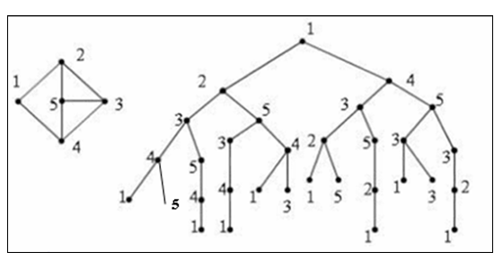
List all Hamilton’s cycles using Backtracking

Slide 70
Graph coloring
Definition
Chromactic number
Types of graph coloring
Method

Slide 71
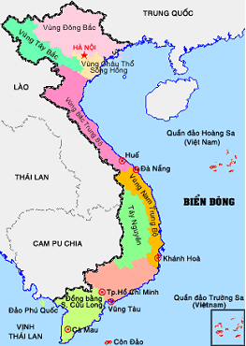
Graph coloring
Graph coloring is one of the basic problems of Graph theory, widely used in informatics, to solve practical problems related to zoning, grouping, and maps.

Slide 72
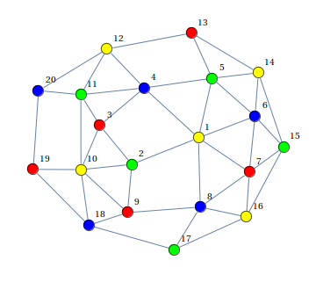
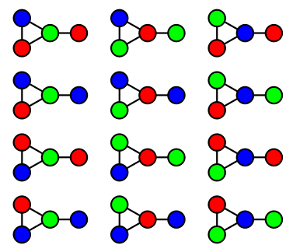
Graph coloring
In graph theory, graph coloring is a way of coloring the vertices of a graph such that no two adjacent vertices share the same color.

Slide 73
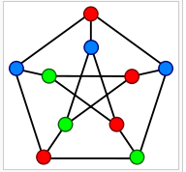
Graph coloring
The chromatic number of a graph is the minimum number of colors one can use to color the vertices of the graph so that no two adjacent vertices are the same color.
Chromatic number of the graph G is denoted by χ(G).
1 <= χ(G) <= n
Note: n are vertices of graph

Slide 74
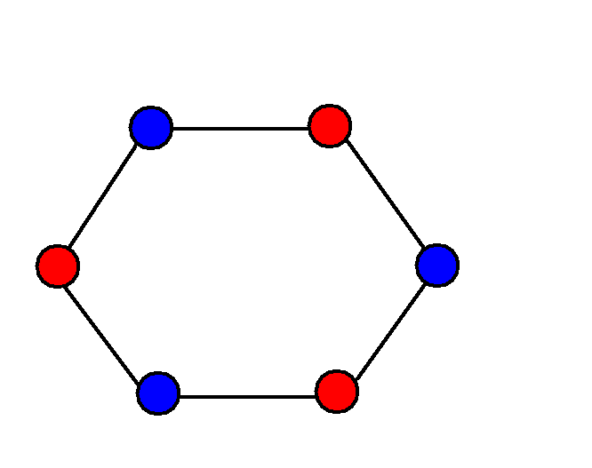
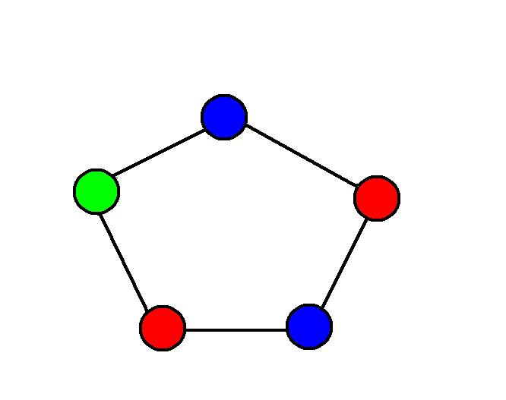
Graph coloring
Cycle graph
Any odd length cycle will have a chromaticity of 3 : χ(C_{2n+1})=3
Any even length cycle will have a chromaticity of 2: χ(C_{2n})=2

Slide 75
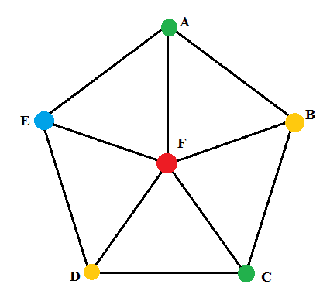
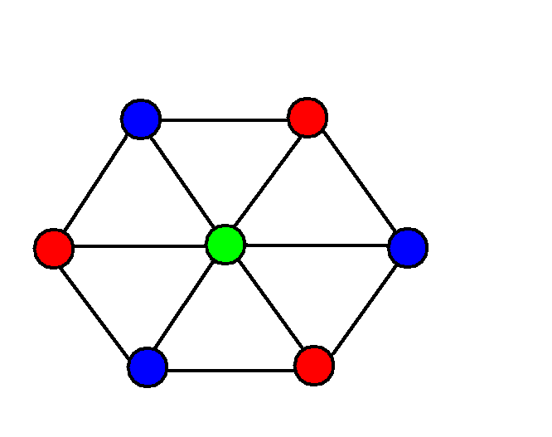
Graph coloring
Wheel graph
If G contains a subgraph isomorphic to Kn then χ(G) >= n

Slide 76
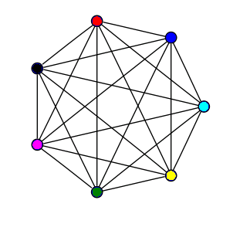
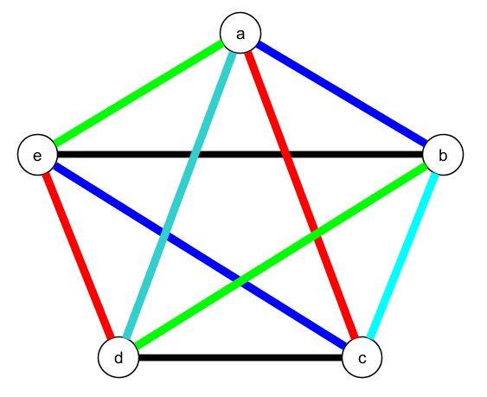
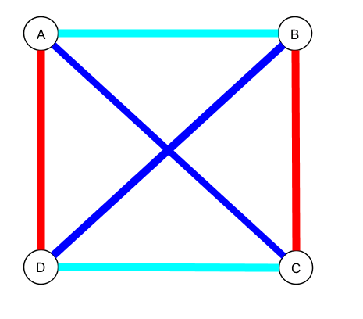
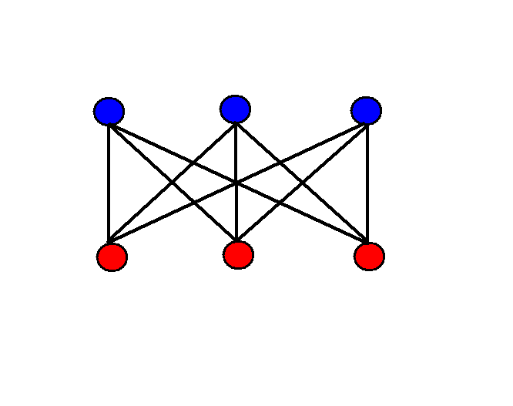
Graph coloring
Graph complete : χ(K_{n})=n
Bipartite graph χ(G)≤ 2

Slide 77
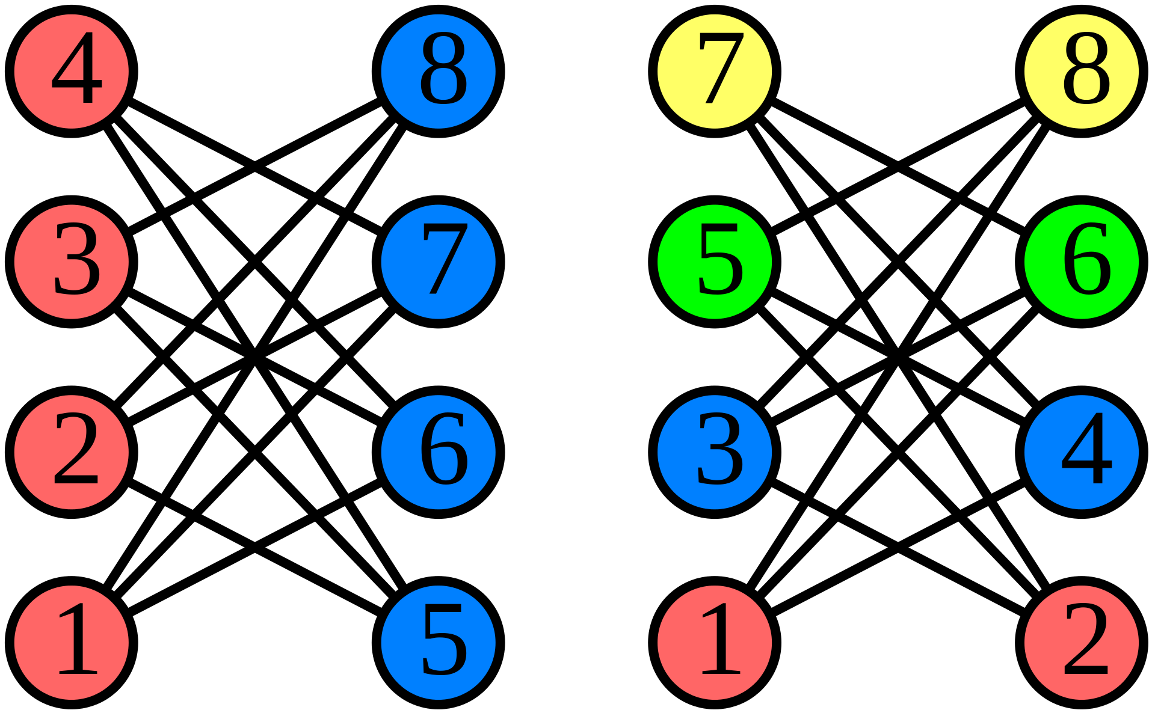
Graph coloring - 2
Sequential coloring establishes the sequence of vertices before coloring them, and then color the next vertex with the lowest number possible

Slide 78
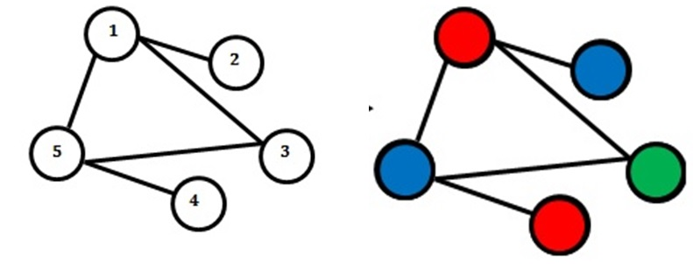
Largest first sequence
Step 1: We have a graph with 5 vertices numbered 1, 2, 3, 4, 5 with the ranks corresponding to each vertex in the order of 3, 1, 2, 1, 3. Hence V 'initially The order is [1, 5, 3, 2, 4]. Assign i = 1 (number of shaded colors).
Step 2: Color 1 (red) for vertex 1. In turn, browse the remaining vertices in V '.
We have: Point 5 is adjacent to vertex 1 (vertex 1 is colored 1 - red), so there is no color for vertex 5. Similarly, vertices 3, 2 are adjacent to vertex 1, so vertices 3, 2 have not been colored.
Vertex 4 is not adjacent to vertex 1, so color 1 for vertex 4. Vertex 4 has color 1 - red.
Step 3: Check that there are still unpainted vertices in V, so go to step 4.
Step 4: Remove the colored vertices 1, 4 from V ', rearrange V' in descending order, we get V '= [5, 3, 2]. We have i = 2. Repeat step 2:

Slide 79
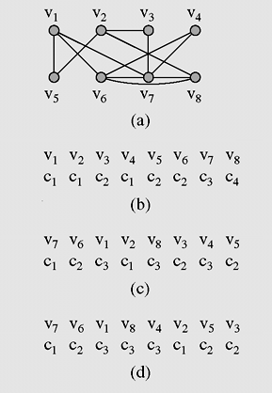
Graph Coloring - 3
A graph used for coloring
(b) colors assigned to vertices with the sequential coloring algorithm
(c) vertices are put in the largest first sequence
(d) vertices are put in the largest first sequence

Slide 80
Summary
80
Spanning Trees
Prim algorithm
Kruskal algorithm
Eulerian and Hamilton Graphs
Graph coloring

Slide 81
Reading at home
Text book: Data Structures and Algorithms in Java
14.7 Minimum Spanning Trees - 662
14.7.1 Prim-Jarn´ık Algorithm - 664
14.7.2 Kruskal’s Algorithm - 667
(Euler's tour and Euler's cycle, exercise C.14.5.2)

